Slide 1

We deserve arrays • 19.12.2021 • Milestone 4

Slide 2
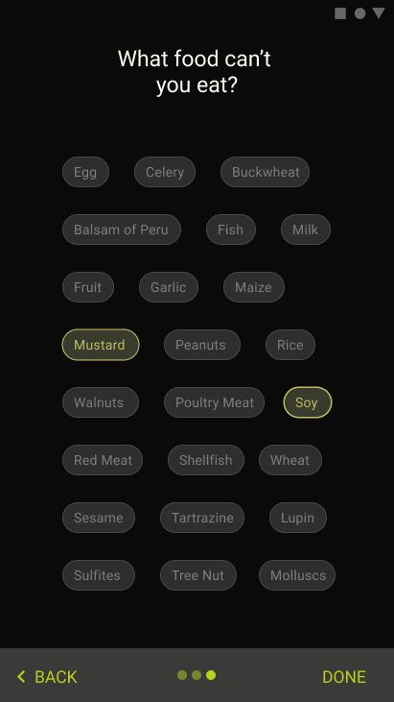
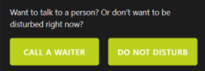
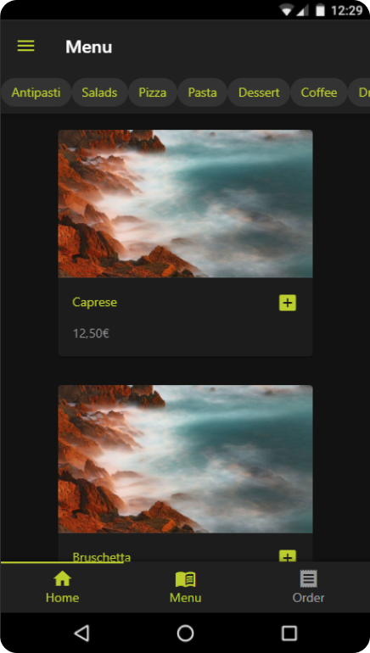
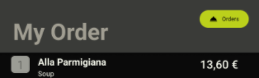
Bad overview
No feedback
Qualitative Evaluation Conclusions
Onboarding Screen confusing
→Increase Consistency, Explanation
Call A Waiter / DND
Users unsure about system status
→ Give more Feedback
Onboarding
Logic intransparent
not self-explanatory
Order Logic not clear yet
→ Rename, Reposition
Food Filtering Logic unclear
→ More Transparency and Help
Filtering Logic
Ordering system
Notes:
Address “universal Design?”

Slide 3
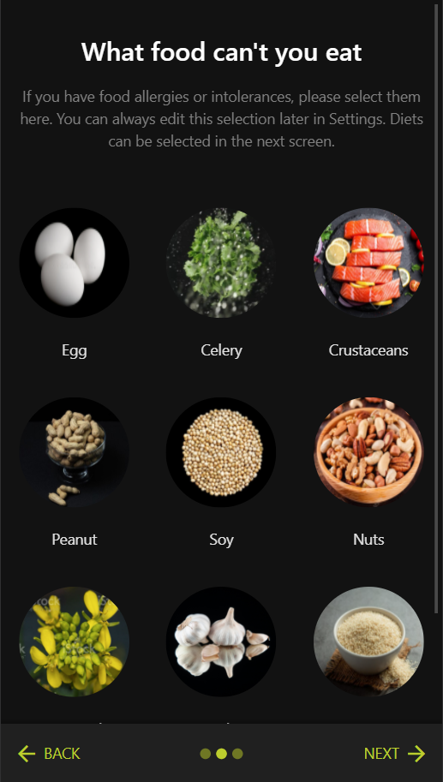
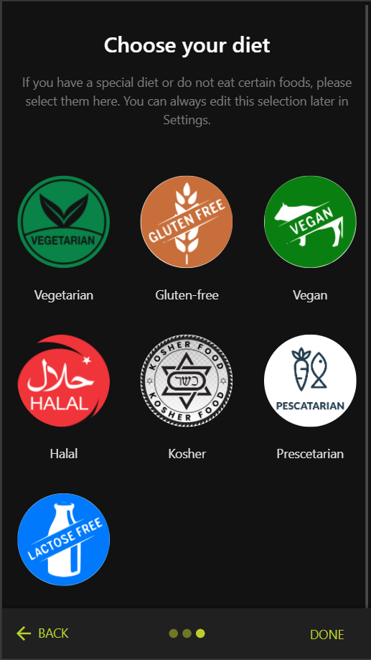
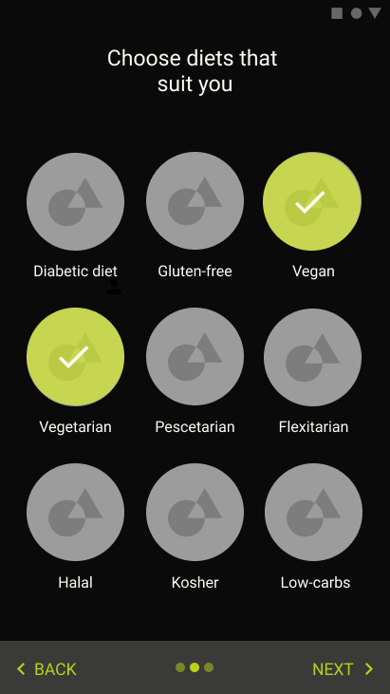
Life Cycle:
Notes:
Cue words - to know when to click:
1st Click = CLEARER
2nd Click = EASILY
3rd Click = SAME DESIGN
4th click (Next Slide) = CONSISTENCY
Feedback:
Crosses instead of Checkmarks
Instead of loading bar > Go for progress bar or cooking animation
Dont differentiate between Previous and Past orders in the Payment screen
Amount of food (vine glass etc.) should be higher hyrrarchiy /more visible
Thinking aloud =/= Measuring time
Call a Waiter in red doesnt look like a button

Slide 4
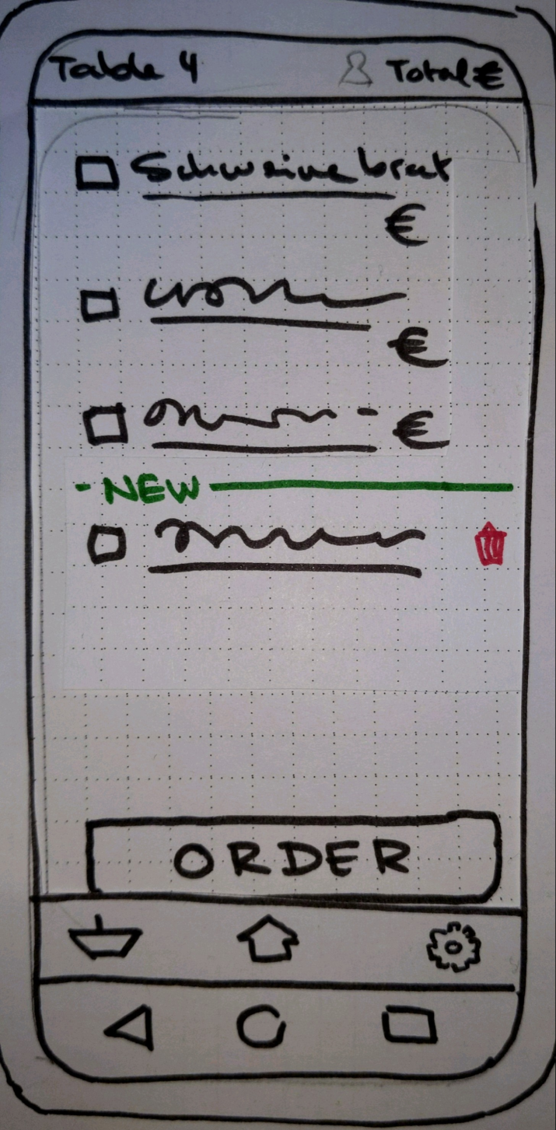
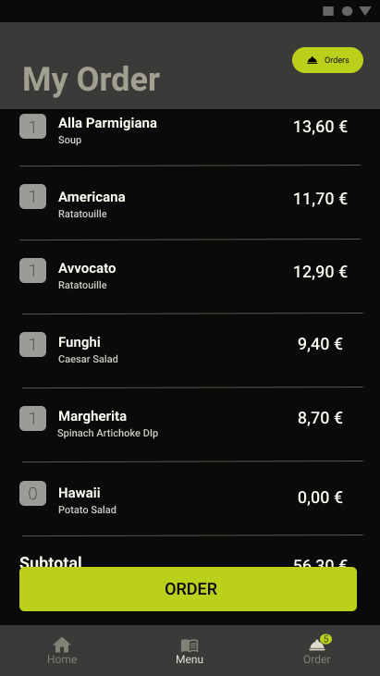
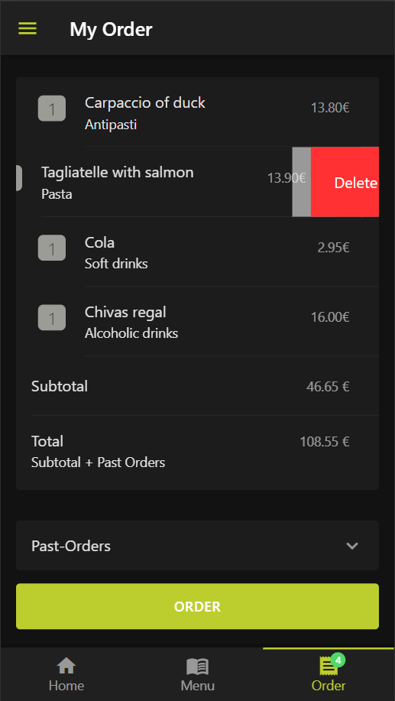
Life Cycle:
Notes:
Cue words - to know when to click:
1st Click = PAPER PROTOTYPE
2nd Click = AND BELOW THAT
3rd Click (Next Slide) = SUBSEQUENTLY

Slide 5
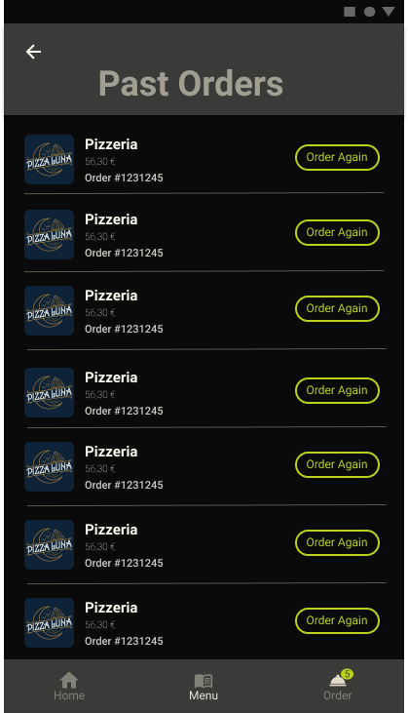
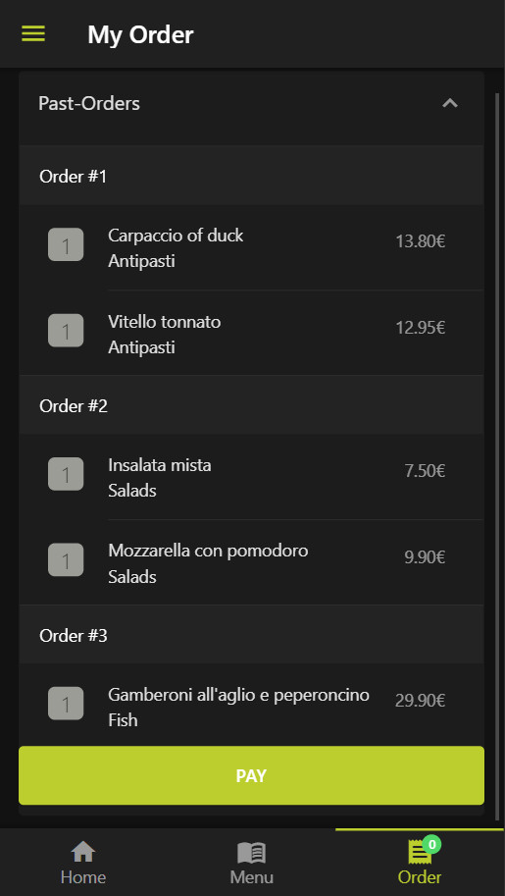
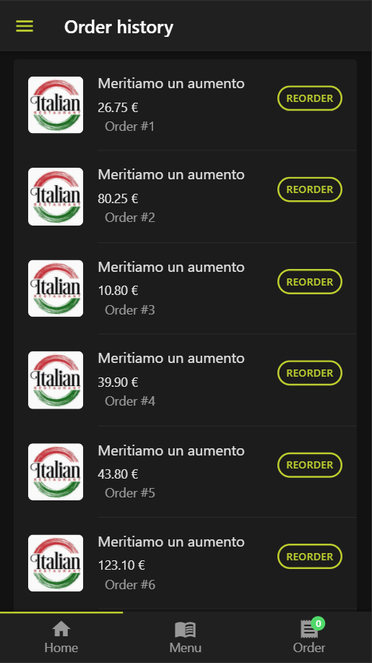
Life Cycle:
Notes:
Cue words - to know when to click:
1st Click (Next Slide) = PAID FOR

Slide 6
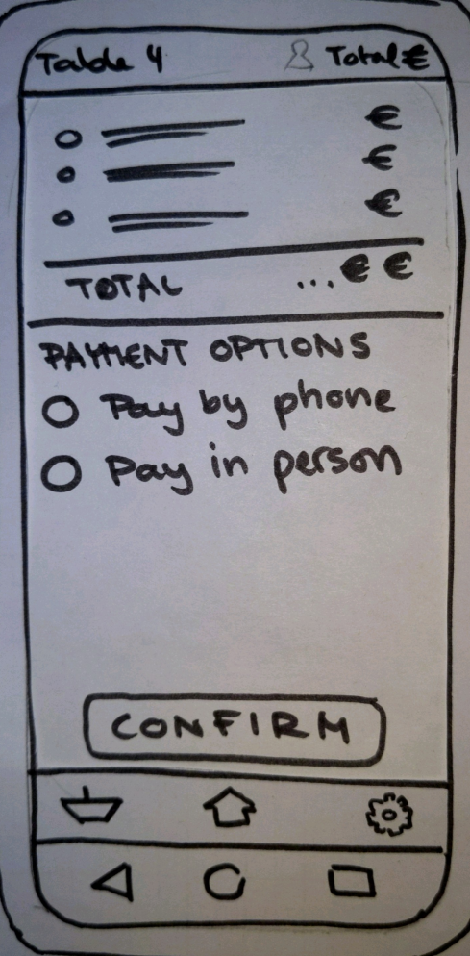
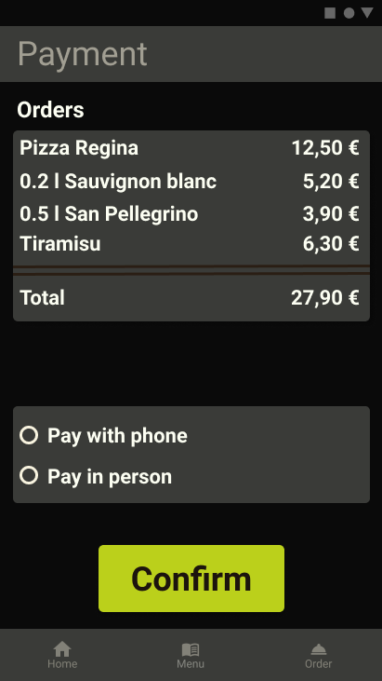
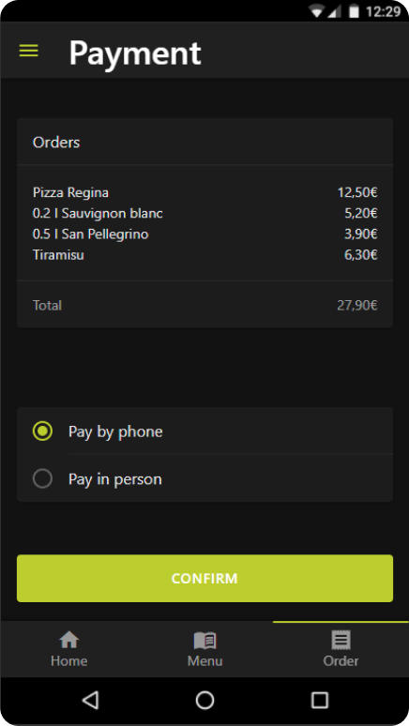
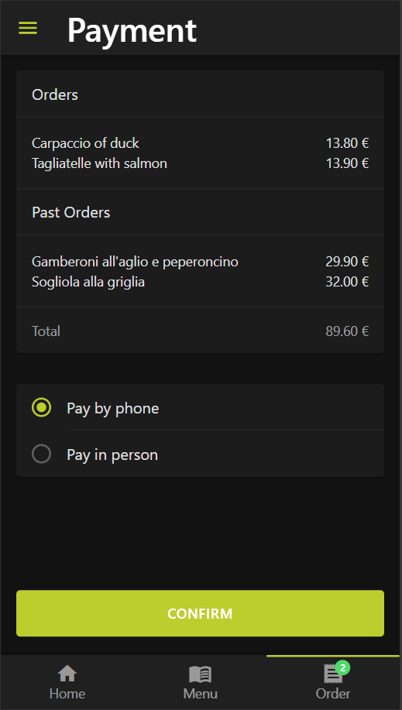
Life Cycle:
Notes:
Cue words - to know when to click:
1st Click = PAST ORDER SUMMARY:
2nd Click (Next Slide) = FORGOT WHAT YOU ATE!

Slide 7
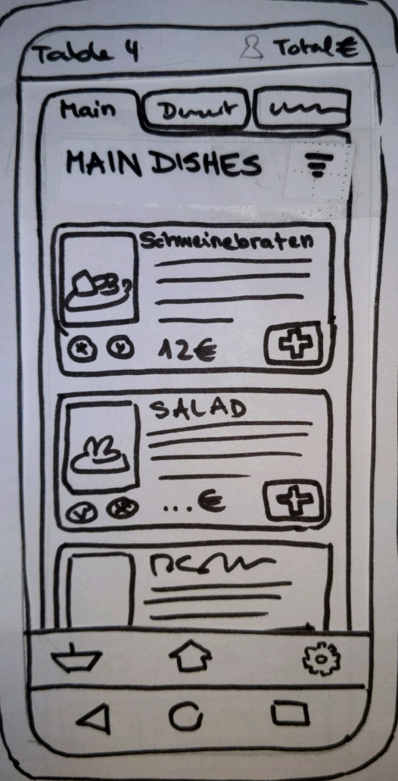
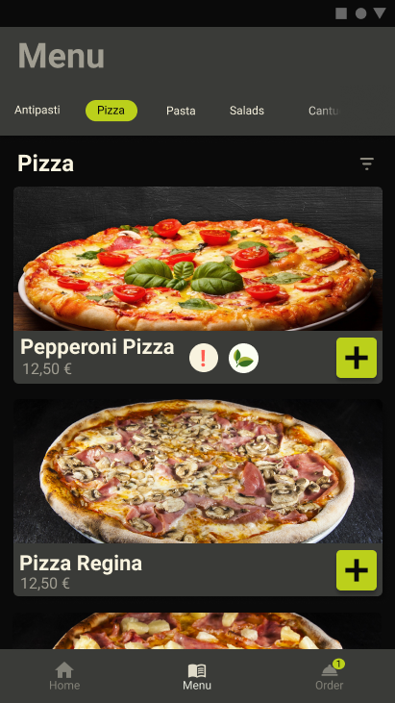
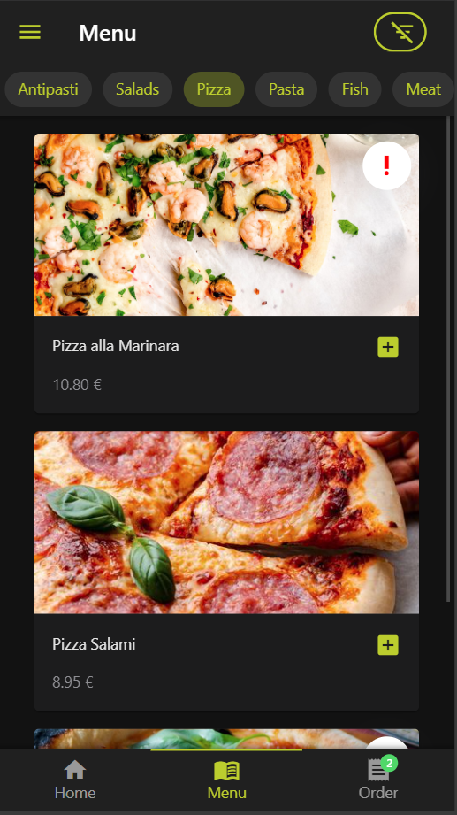
Life Cycle:
Notes:
Cue words - to know when to click:
1st Click = ALLERGY WARNINGS
2nd Click (Next Slide) = FUNCTIONALITY!

Slide 8
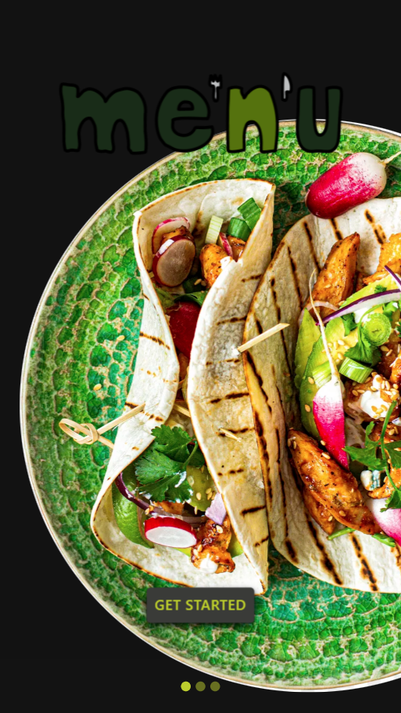
Prototype Live Demo

Slide 9
Quantitative Evaluation
Hypotheses:
The user should be able to order food within 15 seconds
They can achieve their goals efficiently.
The app is accessible and accommodates to all types of users.
The app recognises, respects and caters to the users needs by helping them apply those needs in the restaurant.
The prototype achieves at least a score of 80 in the evaluation with the SUS.
Measurements:
Time to complete task
Number of clicks
Number of errors
Number of positive and negative statements towards the system
Number of users completing task successfully (w/o assistance)
Number of system features user remembers afterwards
System Usability Scale (SUS)

Slide 10
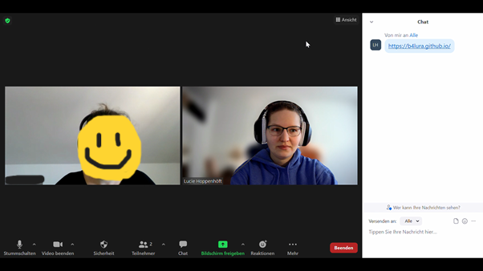
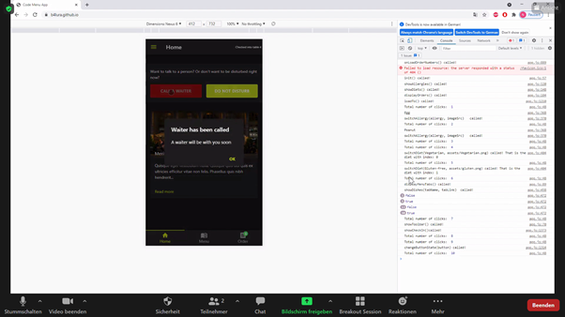
Procedure:
Setup
Demographic Information
Scenario
Test Cases
SUS
Follow Up Question
Setup:
Zoom + Screen Sharing
Chrome w/ open Console
Nexus 6
Image and Sound Recording
Thinking Aloud Method

Slide 11
Discussion
Notes:
-past orders on same screen as orders

